Slide 1
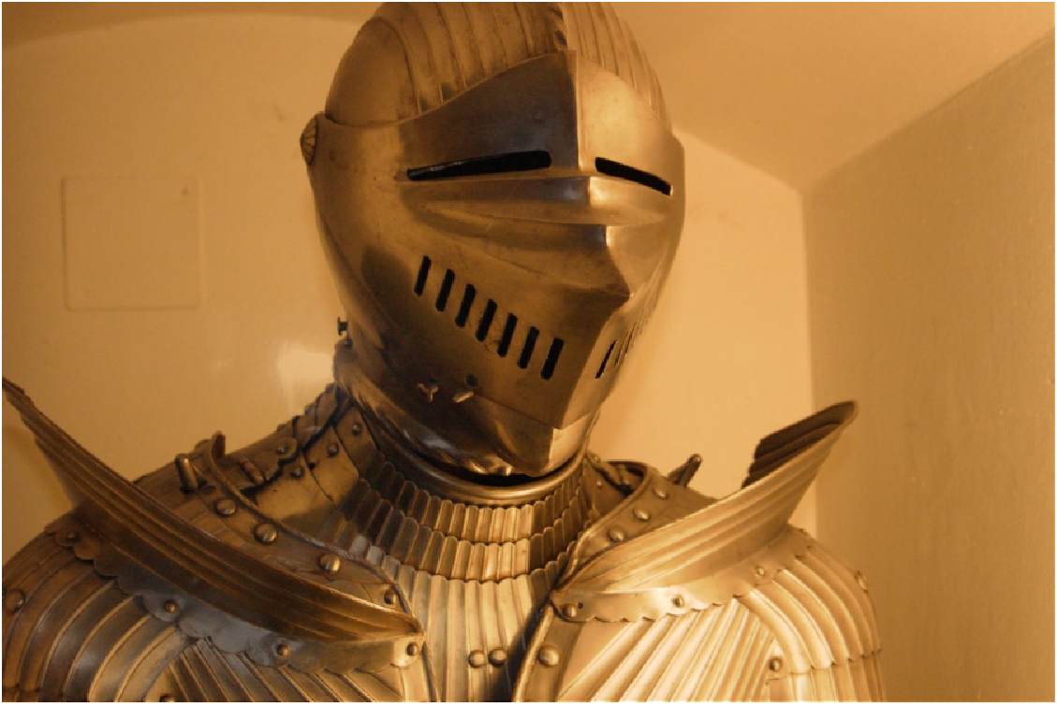
Digital photography with flash and no-flash Image Pairs
Group Members:
Shreyas Narahari - 203050037
Raj Sudam Gite – 203050092
Himanshu Meena - 150070027

Slide 2
Objective of this project
Denoising and Detail Transfer
Denoising
Detail Transfer
Shadow and Specularity Detection
White Balancing
Continuous-Flash Adjustment

Slide 3
Denoising and Detail Transfer

Slide 4
Denoising and Detail Transfer
Ambient image A contains the lighting information(ambience) but its noisy due to low light conditions.
Flash image F, on the other hand contains the details in the regions where the flash reaches and has better SNR than ambient image.
Our aim is to denoise A and transfer the details from F to denoised A.
But it creates some problems that we will address further and tackle it.

Slide 5
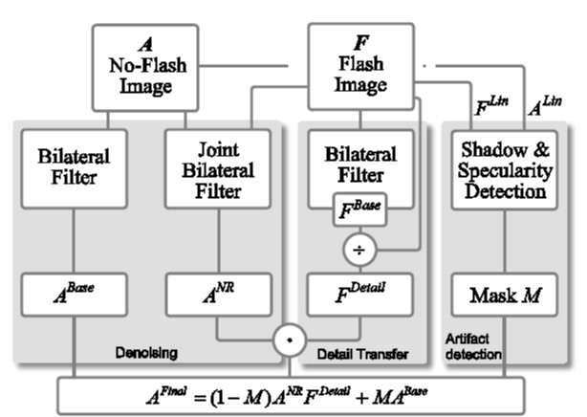
Denoising and Detail Transfer

Slide 6
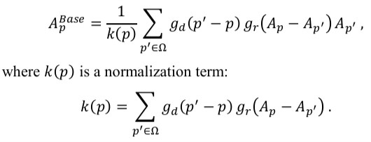
Denoising
Bilateral Filter is used for denoising but it over blur and under blur the images.
Following hyper parameters for gaussians are used:
Std. Dev. (spatial) = 25 Std. Dev. (intensity) = 5% to 10% of intensity range

Slide 8
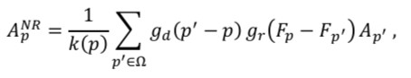
Denoising
Joint Bilateral Filter helps to combat this as we are using F for determining the weights of intensity gaussian.
Following hyper parameters for gaussians are used:
Std. Dev. (spatial) = 25 Std. Dev. (intensity) = 0.1% of intensity range

Slide 10
Denoising
Difference between Basic and Joint Bilateral can be seen from this difference image

Slide 11

Detail Transfer
The method used for detail transfer is same as discussed in the paper.
The ratio of flash and bilateral filter flash image is used to obtain image containing details,
$$F_{detail}= \frac{F+ ε}{F^{Base}+ ε}$$
Here, $ε=0.02$ is used to avoid division by zero.

Slide 12
Detail Transfer – Flash Image (F)

Slide 13

Detail Transfer – Bilateral of Flash (F^{Base})

Slide 14
Detail Transfer – Detail of Flash (F_{detail})

Slide 15
Detail Transfer – Details Transfered

Slide 16
Detecting Flash Shadows and Specularities
The shadows were detected using the fact that illumination difference between the flash image and the no flash image should be higher at every pixel but due to shadows some of the pixels will be lower than the ambient level. We detect such pixels and include them in our shadow mask. To calculate the luminance a weighted sum of R, G, B components of image is used,
Y = 0.2989*R + 0.587*G + 0.114*B
To detect specularities, we detect the pixels where luminance is higher than 95%.
We then, form the final mask by taking union of Shadow & Specularities Image. This final mask is then blurred using gaussian filter.

Slide 17
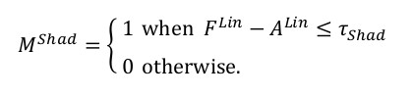
Detecting Flash Shadows and Specularities

Slide 18
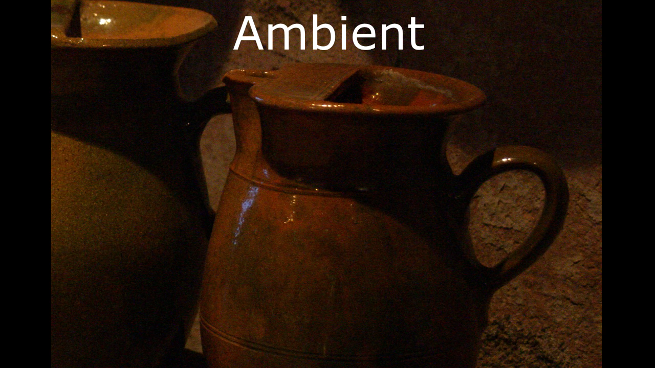
Detecting Flash Shadows and Specularities

Slide 19
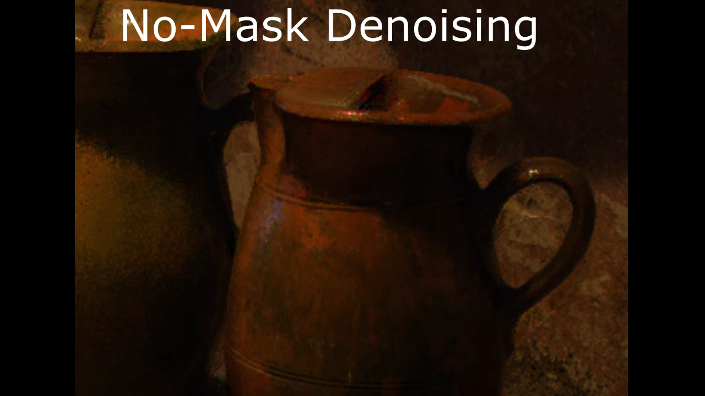
Final Denoising Image

Slide 20
White Balancing

Slide 21
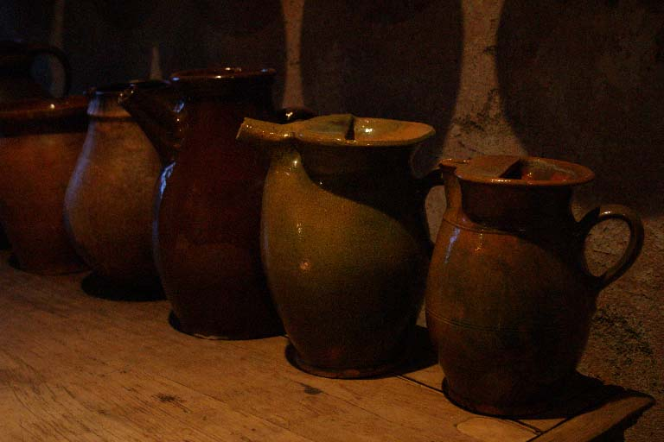
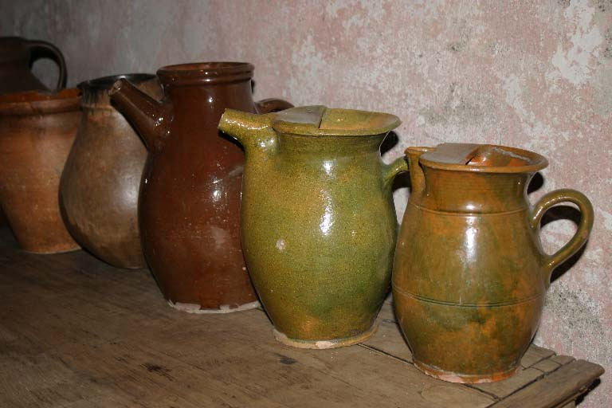
White Balancing
Ambient
Flash

Slide 22
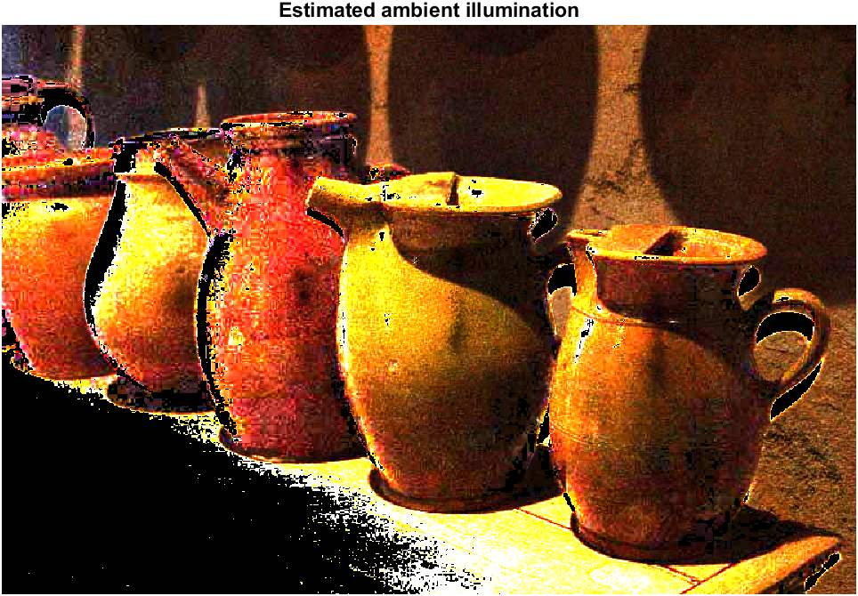
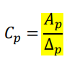

White Balancing
Δ = 𝐹^{𝐿𝑖𝑛} − 𝐴^{𝐿𝑖𝑛}
Estimated ambient illumination colors:

Slide 23
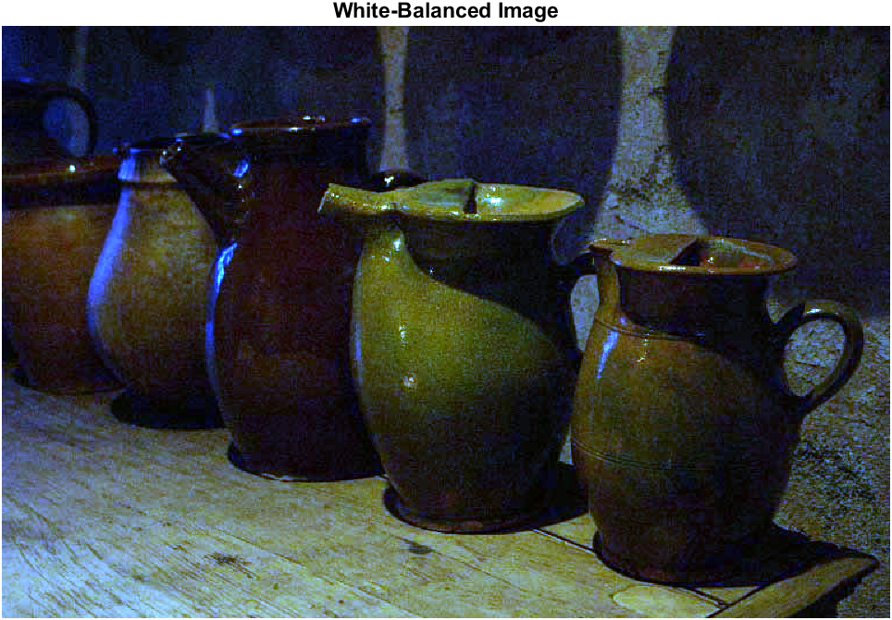
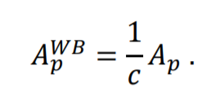
White Balancing

Slide 24
Continuous Flash

Slide 25
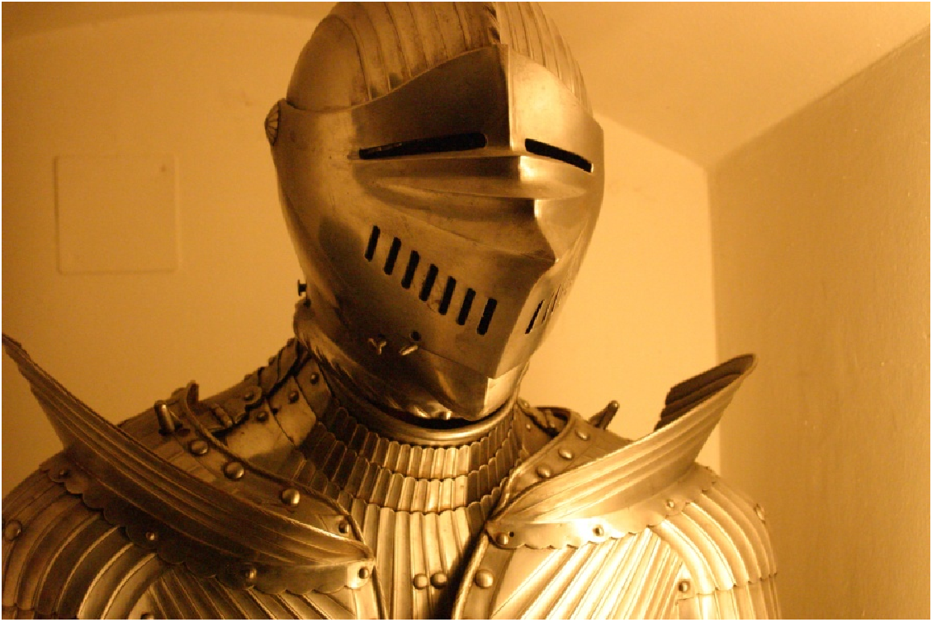
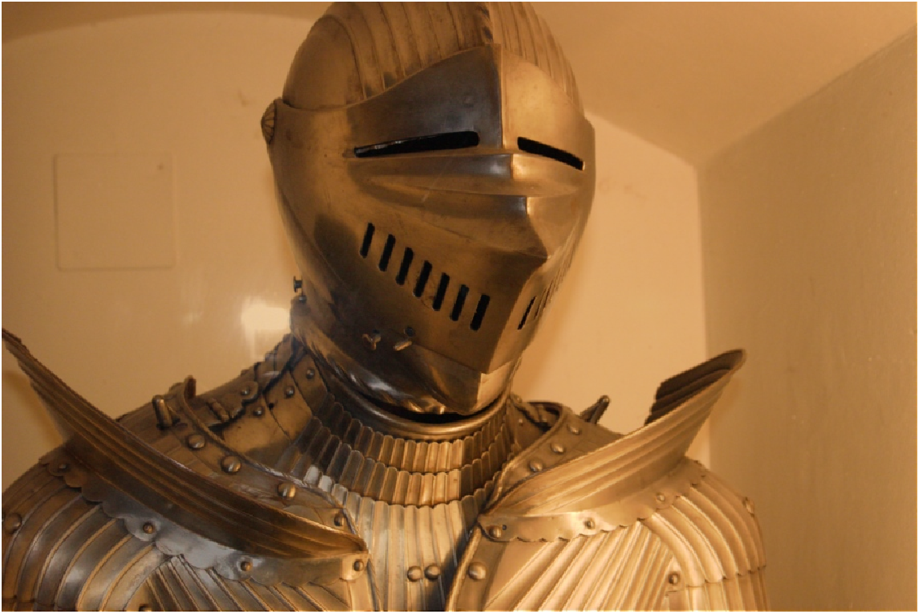
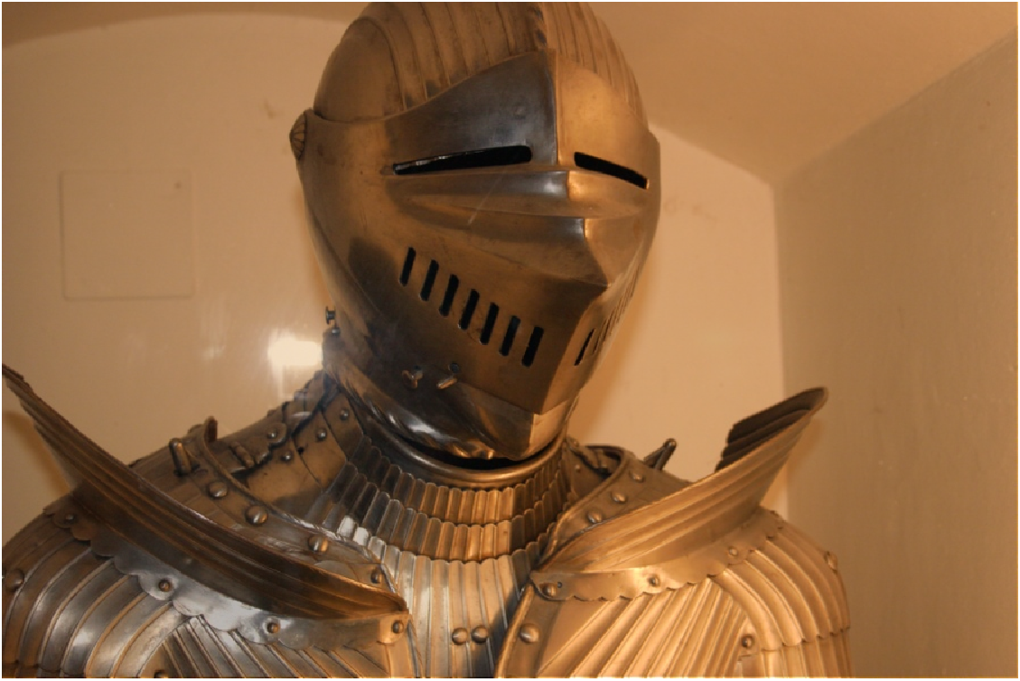
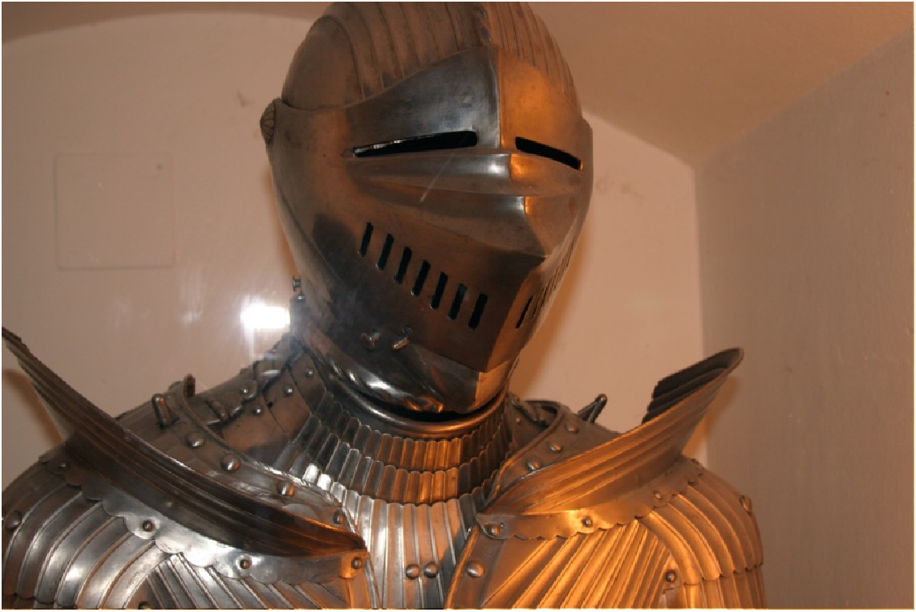
Continuous Flash
Alpha = 0.0
Alpha = 0.32
Alpha = 0.5
Alpha = 0.68
Alpha = 0.0

